Slide 1


Center of Excellence for
Building Decarbonization (CEBD)
Cold-Climate Design 101
For Decarbonization

Slide 2

Agenda
Introduction
Cold-Climate Challenges
Cold-Climate Solutions
Design to Reduce Emissions
ASHRAE Update

Slide 3

Introduction

Slide 4
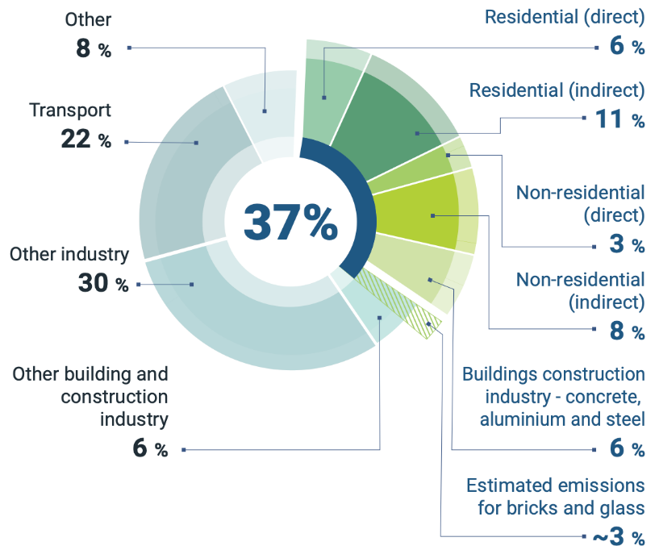
Global building sector energy-related CO₂ emissions,
2021
Source: IEA 2022. All rights reserved. Adapted from "Tracking Clean Energy Progress" (IEA 2022f). https://www.unep.org/resources/publication/2022-global-status-report-buildings-and-construction

Slide 5
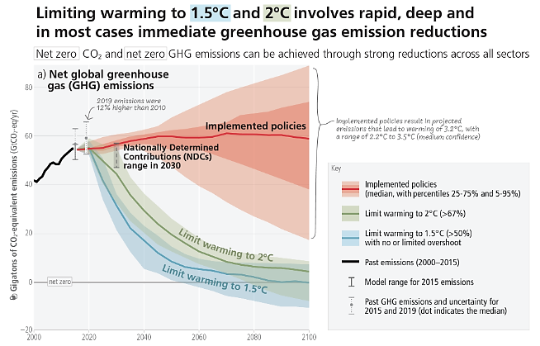
Net GHG Emissions Reductions Needed to Minimize Catastrophic Climate Change
Source: IPCC AR6 Synthesis Report on Climate Change 2023. All rights reserved. https://www.ipcc.ch/report/ar6/syr/figures/figure-spm-5

Slide 6
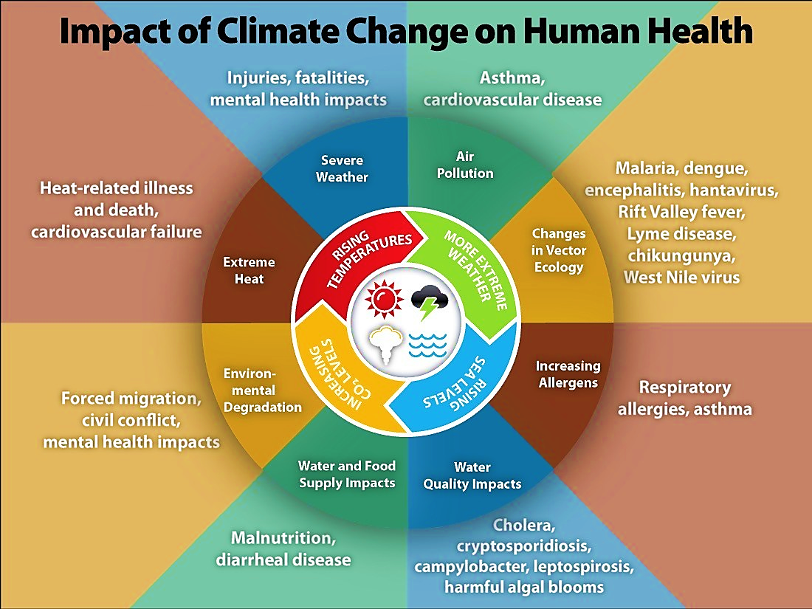
Directly Impacting The Work Of ASHRAE Members
Source: United States Centers for Disease Control and Prevention. All rights reserved. https://www.cdc.gov/climateandhealth/effects/default.htm

Slide 7
Directly Impacting
Health
Safety
Comfort
Source: United States Centers for Disease Control and Prevention. All rights reserved. https://www.cdc.gov/climateandhealth/effects/default.htm

Slide 8
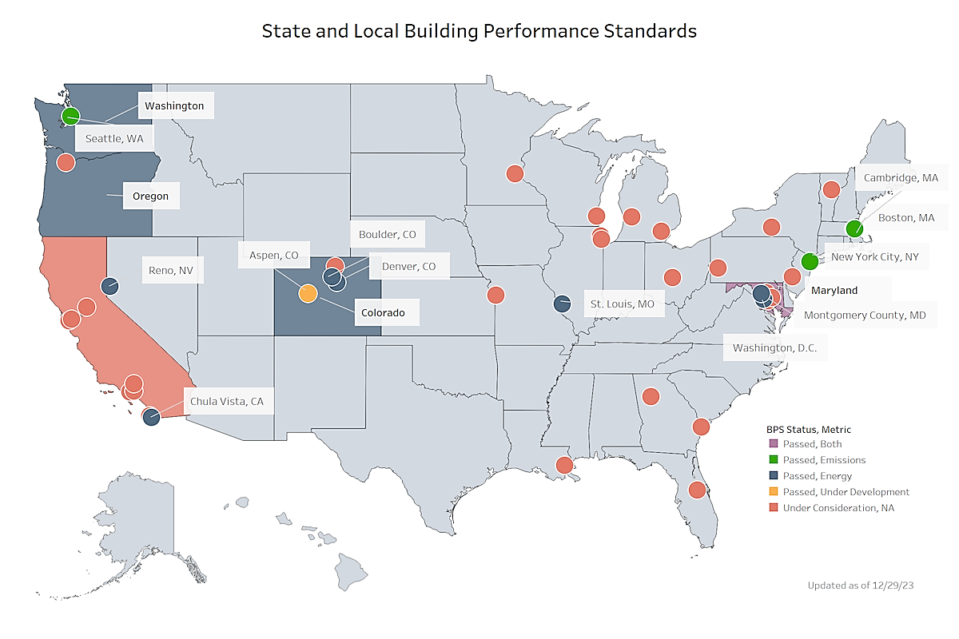
Building Performance Standards Driving Local Emissions Reduction
Requirements
Source: DOE Office of Energy Efficiency and Renewable Energy. https://www.energycodes.gov/sites/default/files/2023-12/Building_Performance_Standards.png

Slide 9
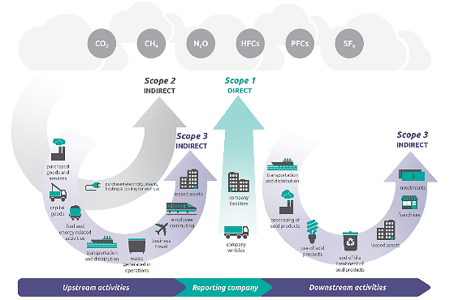
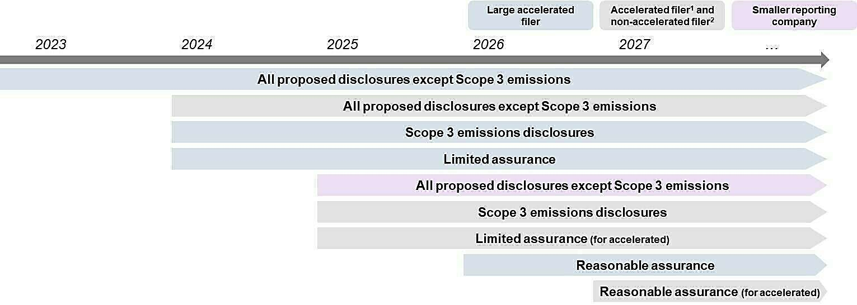
SEC Emissions Reporting Requirements
Publicly Traded Companies FY2023
Source: US Environmental Protection Agency
Source: US DOE

Slide 10

ASHRAE’s position…
Eliminating GHG emissions from the built environment is essential to address climate change
Notes:
ASHRAE’s position is simple. Eliminating GHG emissions from the built environment is essential to address climate change.

Slide 11
ASHRAE goals…
2030
The global built environment must halve its 2015 GHG emissions
All new buildings must be NZE
Widespread EE retrofits of existing assets
New construction embodied carbon must be reduced by at least 40%
2050
All new and existing assets must be net zero GHG emissions across the whole life cycle
Notes:
By 2030, the global built environment must halve its 2015 GHG emissions, whereby
all new buildings must be net zero GHG emissions in operation,
widespread energy-efficiency retrofits of existing assets must be well underway, and
embodied carbon of new construction must be reduced by at least 40%.
By 2050, at the latest, all new and existing assets must be net zero GHG emissions across the whole life cycle.

Slide 12
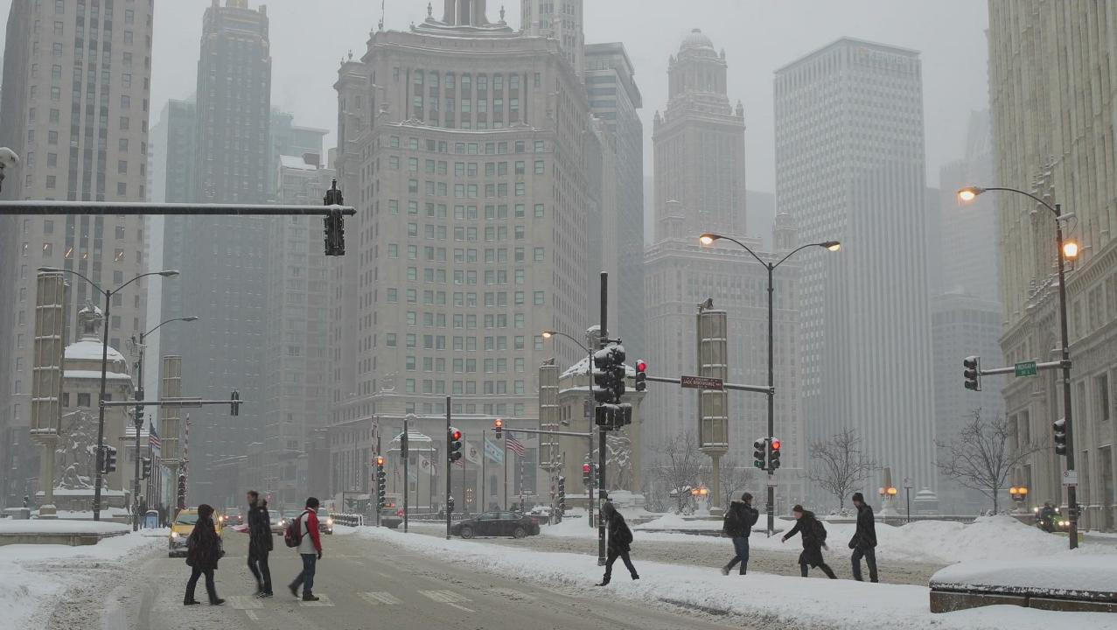
Cold-Climate Challenges

Slide 13
Three Big Challenges:
And All Three relate to Temperature
Challenge 1:
Buildings in Colder Climates Use more Energy (Especially heating) = More Energy End use to decarbonize
Source: U.S. Energy Information Administration, 2020 Residential Energy Consumption Survey (RECS)
Note: Average temperature derived from National Oceanic and Atmospheric Administration (NOAA) weather data for RECS sampled households.

Slide 14
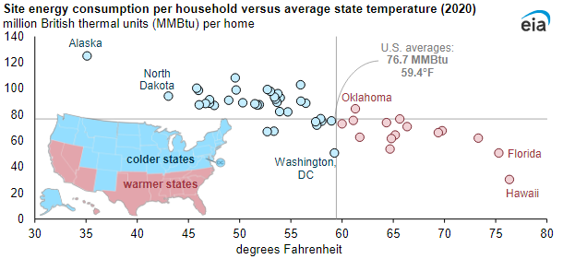
Three Big Challenges:
And All Three relate to Temperature
Challenge 1:
Buildings in Colder Climates Use more Energy (Especially heating) = More Energy End use to decarbonize
Source: U.S. Energy Information Administration, 2020 Residential Energy Consumption Survey (RECS)
Note: Average temperature derived from National Oceanic and Atmospheric Administration (NOAA) weather data for RECS sampled households.

Slide 15
Three Big Challenges:
And All Three relate to Temperature
Challenge 2:
Air-Source Heat Pump Capacity Drops with Outside Air Temperature
Source: U.S. Energy Information Administration, 2020 Residential Energy Consumption Survey (RECS)
Note: Average temperature derived from National Oceanic and Atmospheric Administration (NOAA) weather data for RECS sampled households.

Slide 16
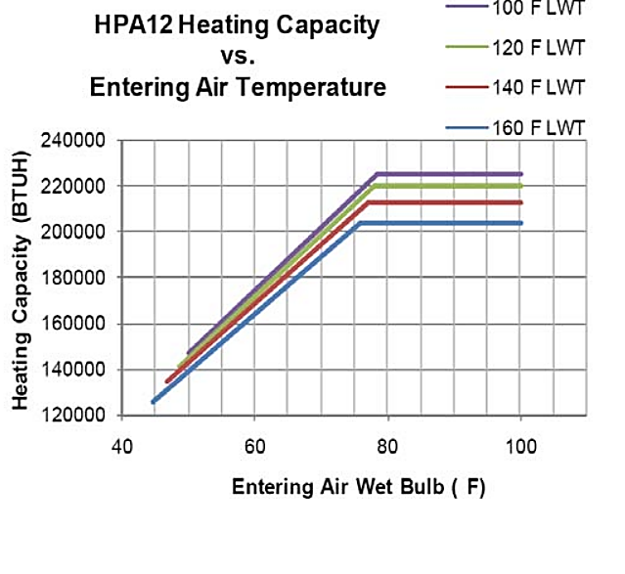
Three Big Challenges:
And All Three relate to Temperature
Challenge 2:
Air-Source Heat Pump Capacity Drops with Outside Air Temperature
Source: U.S. Energy Information Administration, 2020 Residential Energy Consumption Survey (RECS)
Note: Average temperature derived from National Oceanic and Atmospheric Administration (NOAA) weather data for RECS sampled households.

Slide 17
Three Big Challenges:
And All Three relate to Temperature
Challenge 3:
Air-Source Heat Pump Efficiency Drops with Outside Air Temperature
Source: U.S. Energy Information Administration, 2020 Residential Energy Consumption Survey (RECS)
Note: Average temperature derived from National Oceanic and Atmospheric Administration (NOAA) weather data for RECS sampled households.

Slide 18
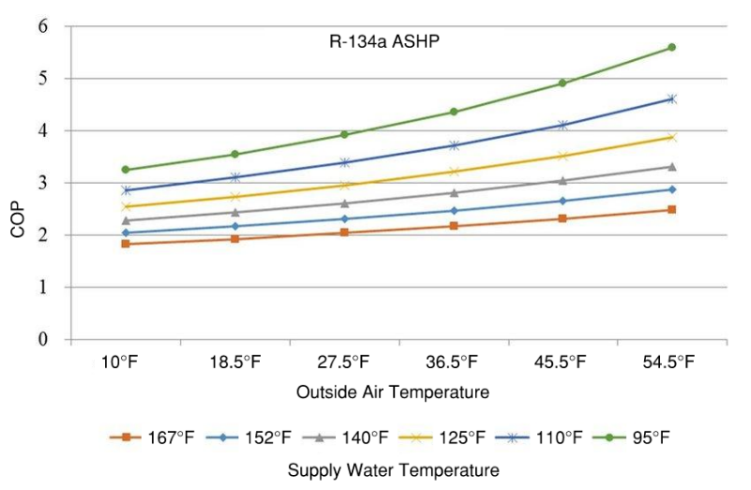
Three Big Challenges:
And All Three relate to Temperature
Challenge 3:
Air-Source Heat Pump Efficiency Drops with Outside Air Temperature
Source: U.S. Energy Information Administration, 2020 Residential Energy Consumption Survey (RECS)
Note: Average temperature derived from National Oceanic and Atmospheric Administration (NOAA) weather data for RECS sampled households.

Slide 19
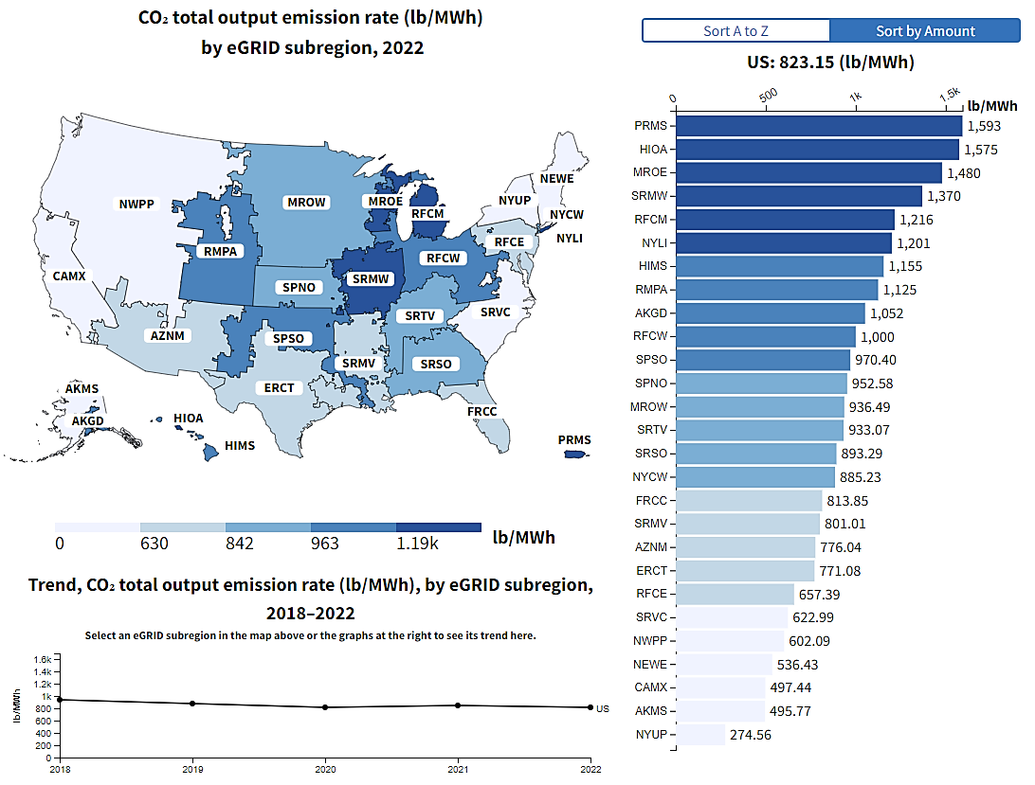
The Grid Challenge:
Emissions Factors
Source:
https://www.epa.gov/egrid/data-explorer
Notes:
Many of the colder regions also have higher grid emissions factors, compounding the challenge of decarbonization

Slide 20
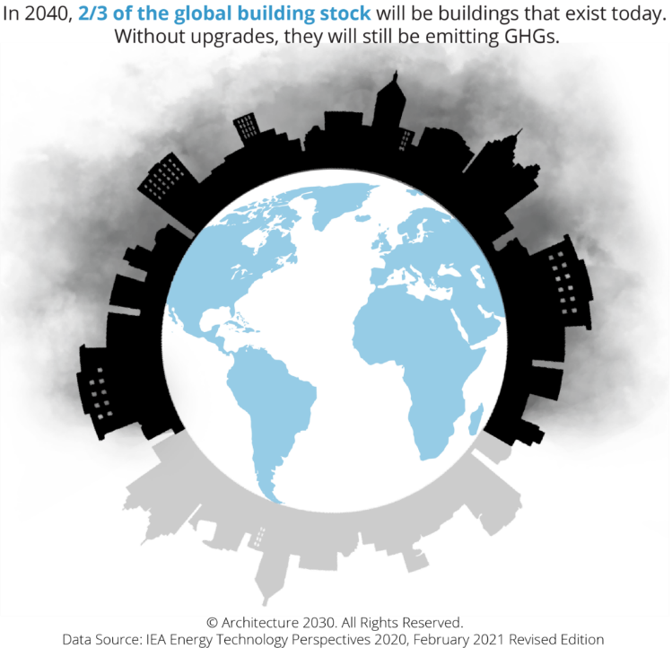
The Existing Building Challenge:
The need for efficiency
Source: https://www.architecture2030.org/intervention-points/

Slide 21
Cold-Climate Solutions

Slide 22

Building Decarbonization
  whole life = operational
  + embodied

Slide 23
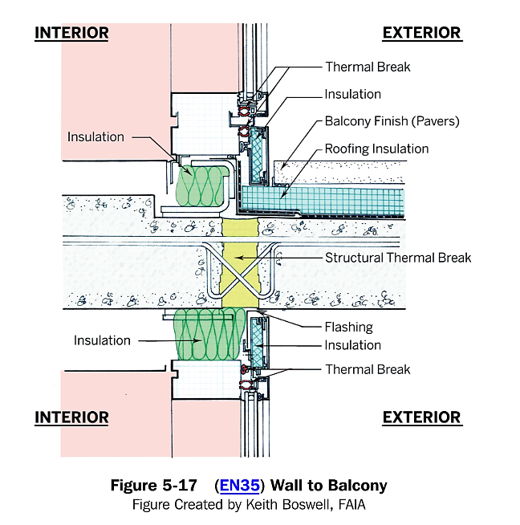
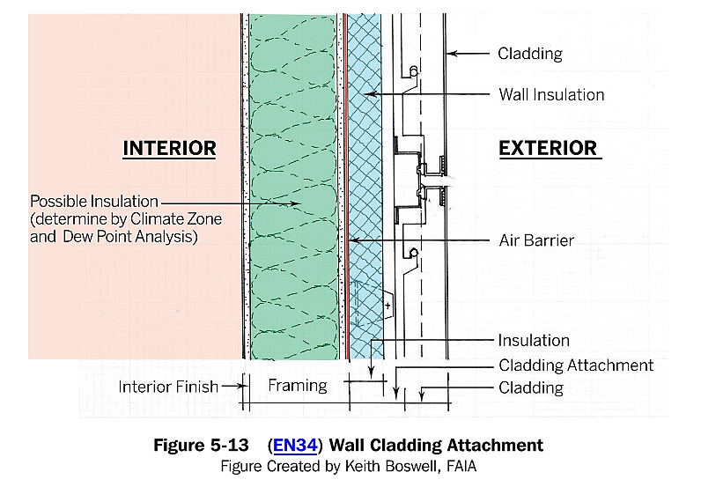
Solution 1:
Enhanced Enclosure Efficiency
Source: ASHRAE 2022 Advanced Energy Design Guide for Zero-Energy Multifamily Buildings

Slide 24
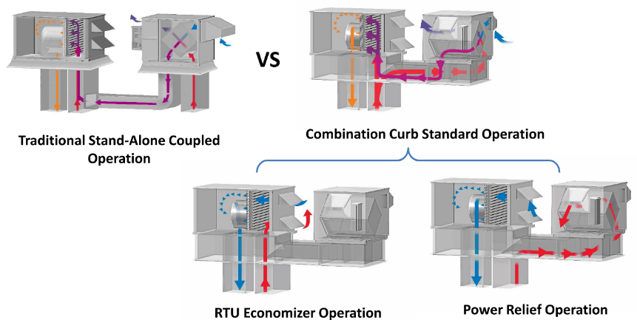
Solution 2:
Heat/Energy Recovery
(AirSide)
Source: ASHRAE 2020 Advanced Learning Institute Air-To-Air Energy Recovery Applications: Best Practices

Slide 25
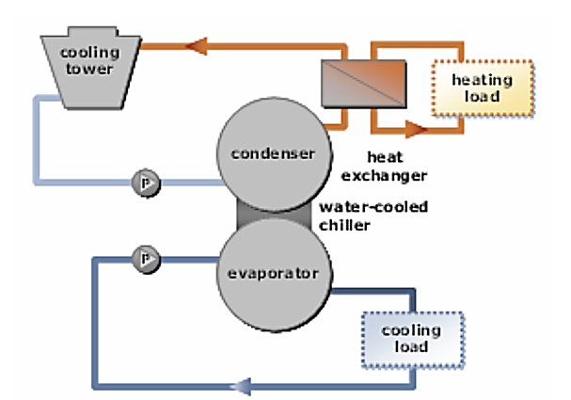
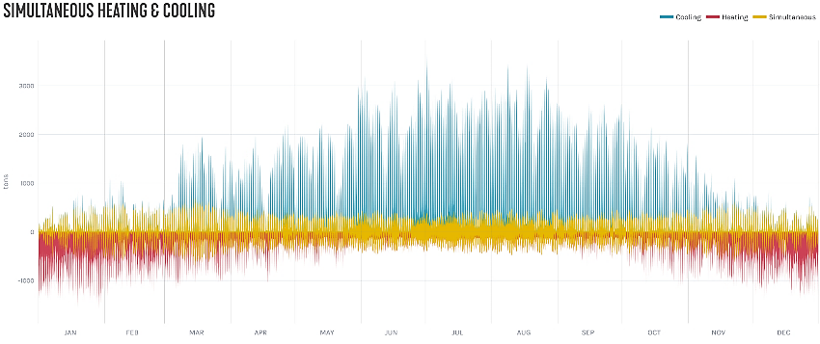
Solution 2:
Heat/Energy Recovery
(Waterside)
Source: Image Courtesy SmithGroup

Slide 26

Solution 2:
Heat/Energy Recovery
(Sanitary-Side)
Source: DC Water Headquarters Image Courtesy SmithGroup

Slide 27
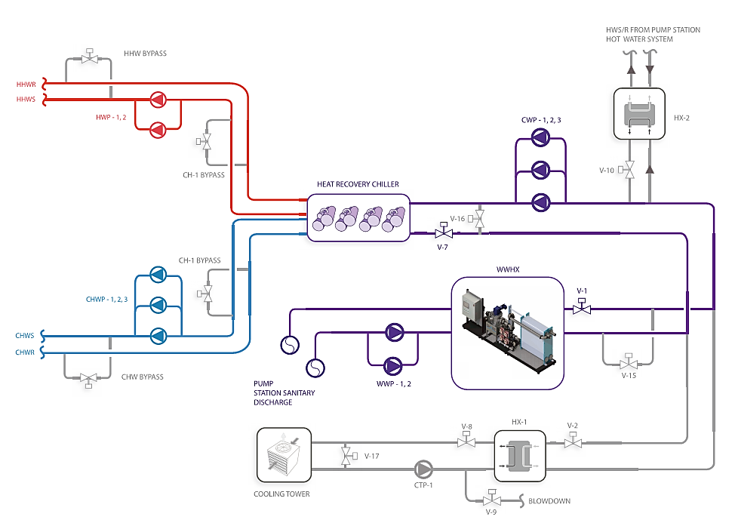
Solution 2:
Heat/Energy Recovery
(Sanitary-Side)
Source: DC Water Headquarters Image Courtesy SmithGroup

Slide 28
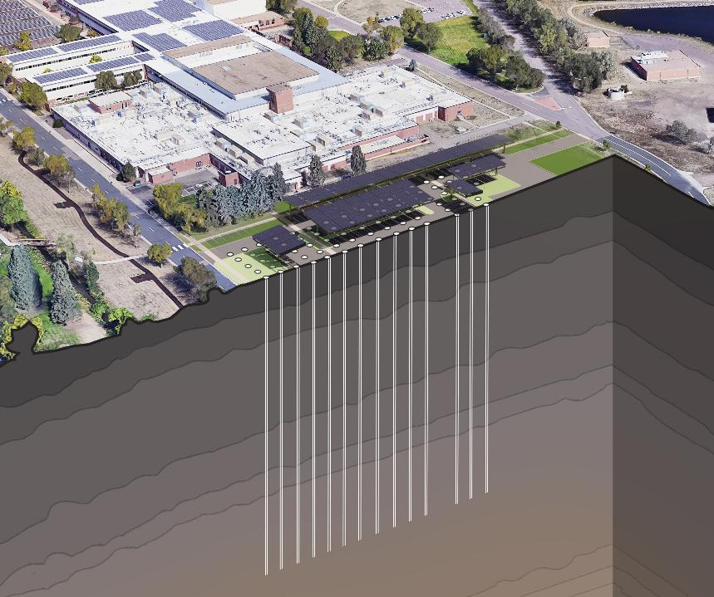
Solution 3:
Right-Sourcing
(GSHP)
Source: Image Courtesy SmithGroup

Slide 29
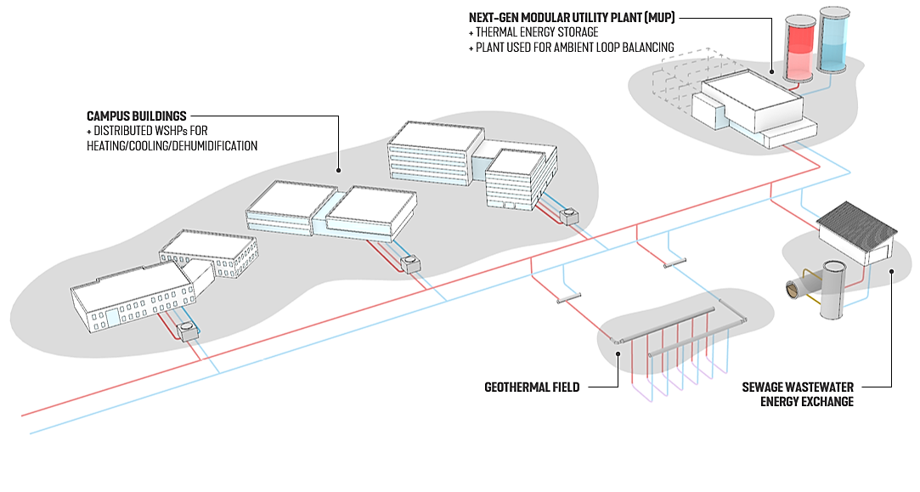
Solution 3:
Right-Sourcing
(Networked District)
Source: Image Courtesy SmithGroup

Slide 30
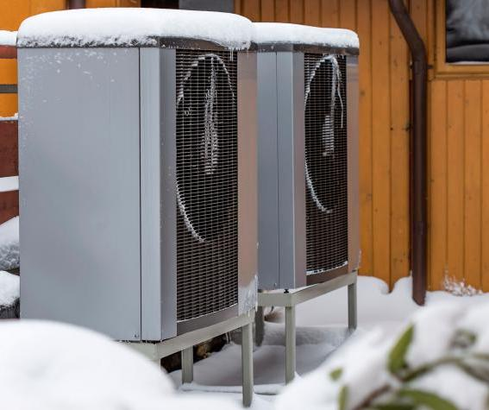
Solution 4:
Advanced Cold-Climate Heat Pump Technologies
Source: Image Courtesy SmithGroup

Slide 31
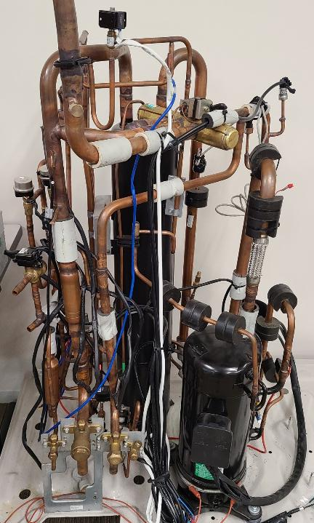
Solution 4:
Advanced Cold-Climate Heat Pump Technologies
(Enhanced Vapor Injection)
EVI is an important technology for enhancing low temperature performance of heat pumps
2
EVI Main Components
Compressor with two suction ports, one in the middle of the scroll to suck saturated vapor, and a traditional suction port for low temp low pressure vapor.
Subcooler (heat exchanger) to extract residual heat from the high-pressure liquid line to warm up some low-pressure liquid refrigerant into a saturated vapor.
1
Source: Pacific Northwest National Laboratory
Notes:
Not all cold climate heat pumps have or utilize EVI. But EVI is an important technology for enhancing low temperature performance of heat pumps.
Example subcooler, part.
https://sdecoice.en.made-in-china.com/product/UyaxXzVogMcm/China-Slhe-Series-Refrigerant-Suction-Line-Copper-Tube-Heat-Exchanger.html

Slide 32
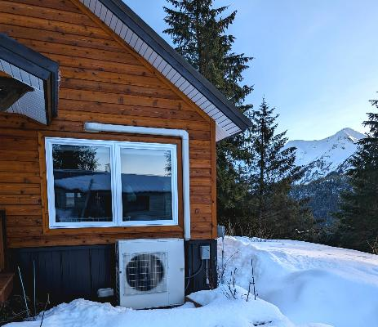
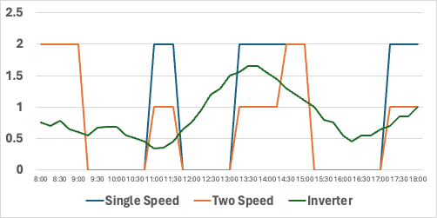
Solution 4:
Advanced Cold-Climate Heat Pump Technologies
(Inverter-Driven Compressors)
Previously
Heat pumps and furnaces relied on 1 or 2 stages of heating to meet the desired setpoint. Full power, half power, and off.
Now
Inverter-driven heat pumps rely on variable-speed operation, allowing them to modulate themselves to maintain a constant setpoint while using less energy. 100% power can modulate down to 0% power, or anywhere in between.
Photo: inverter-driven heat pump installed in PNNL field site in Cordova, AK
Source: Pacific Northwest National Laboratory

Slide 33
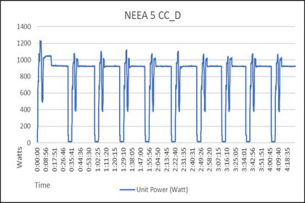
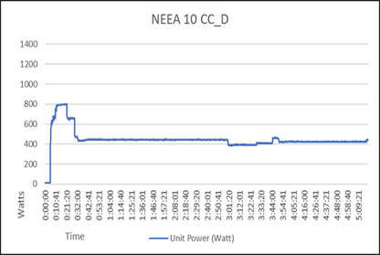

Solution 4:
Advanced Cold-Climate Heat Pump Technologies
(Optimized Controls to Significantly Improve Performance)
Controls Impact - "Old" and "New"
"Old" product: dramatic cycling at virtually all load conditions
"New" product: modulates as expected
Source: Northwest Energy Efficiency Alliance
Under identical testing conditions, the same equipment with new control strategies resulted in a dramatic improvement in efficiency.

Slide 34
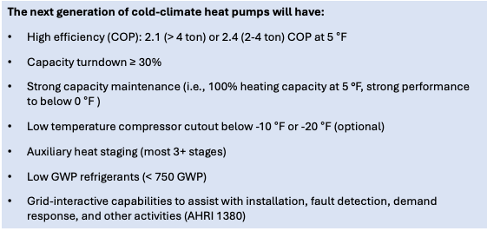
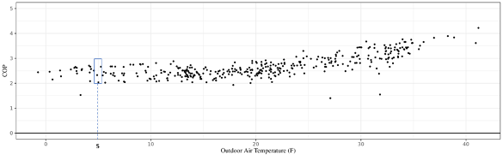
Solution 5:
Advanced Cold-Climate Heat Pump Technologies
(Next Generation Cold Climate Heat Pumps)
Field testing of a new heat pump product provides reliable high-efficiency heating performance in cold climates.
Source: Pacific Northwest National Laboratory
CCHP Challenge: https://www.energy.gov/eere/buildings/residential-cold-climate-heat-pump-challenge
Notes:
Driven by:
Use of EVI,
Larger evaporators and condensers for the rated capacity, and
Smarter control logics

Slide 35
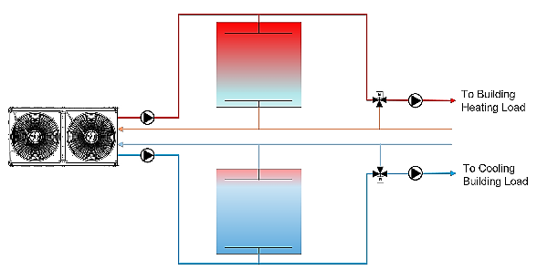
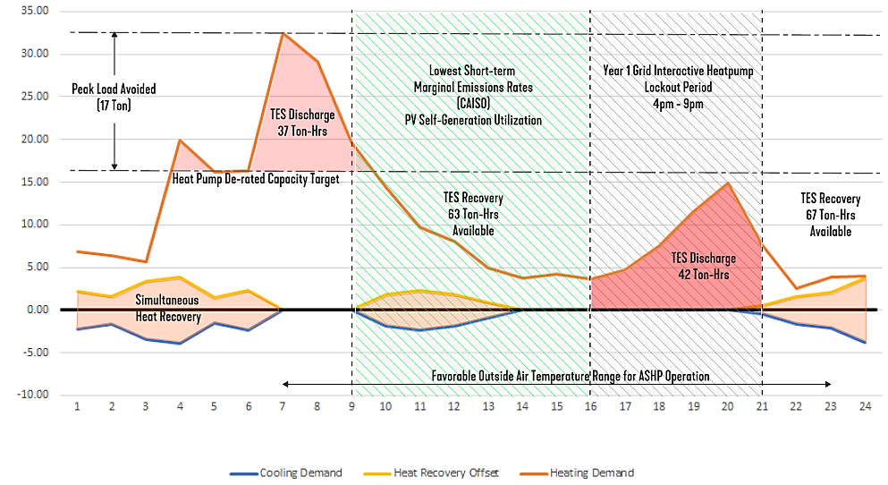
Solution 6:
Advanced Cold-Climate Heat Pump Strategies
(Pairing with Storage)
Source: Images Courtesy of SmithGroup
Notes:
Saving energy during the peak
Maintaining heating/cooling capacity during the extreme/critical hours

Slide 36
Design to Reduce Emissions

Slide 37
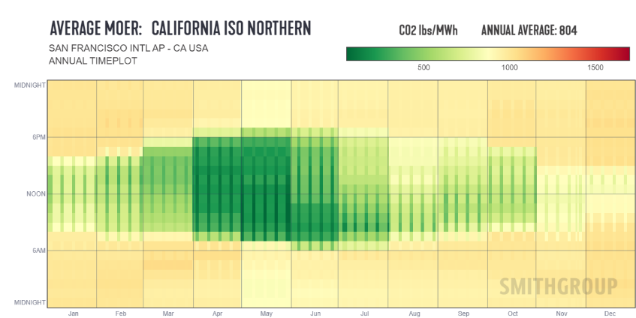
Cold-Climate Design Criteria:
Target Emissions Parity
Source: Images Courtesy of SmithGroup

Slide 38
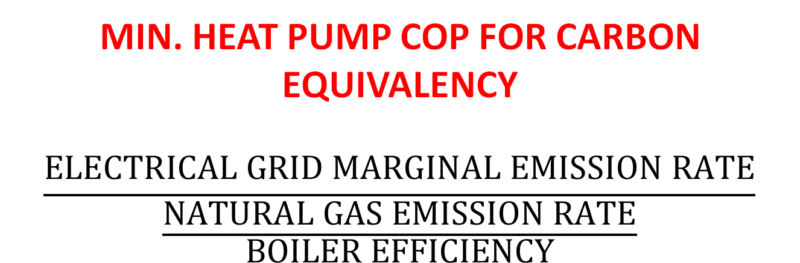
Cold-Climate Design Criteria:
Target Emissions Parity
MIN. HEAT PUMP COP FOR CARBON EQUIVALENCY
$$\frac{ELECTRICAL GRID MARGINAL EMISSION RATE}{\frac{NATURAL GAS EMISSION RATE}{BOILER EFFICIENCY}}$$
Source: Images Courtesy of SmithGroup

Slide 39
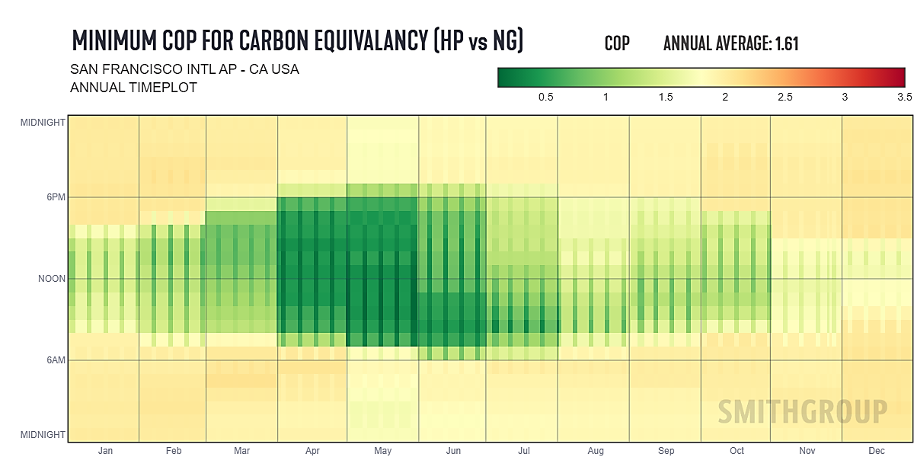
Cold-Climate Design Criteria:
Target Emissions Parity
Source: Images Courtesy of SmithGroup

Slide 40
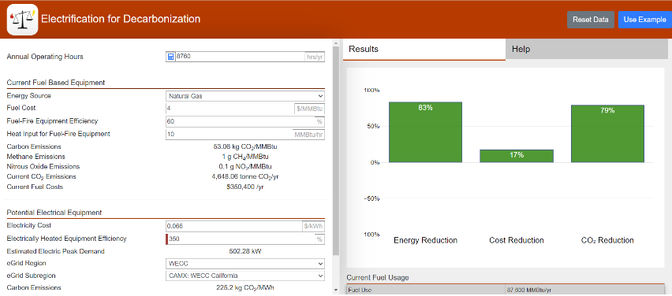
Cold-Climate Design Criteria:
Target Utility Cost Parity
https://electrification.ornl.gov/
Source: Images Courtesy of SmithGroup

Slide 41

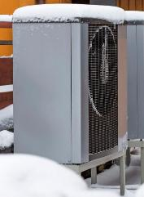
Cold-Climate Design Criteria:
Target Utility Cost Parity
Source: Images Courtesy of SmithGroup

Slide 42
Cold-Climate Design Criteria:
Target Utility Cost Parity
Source: Images Courtesy of SmithGroup

Slide 43
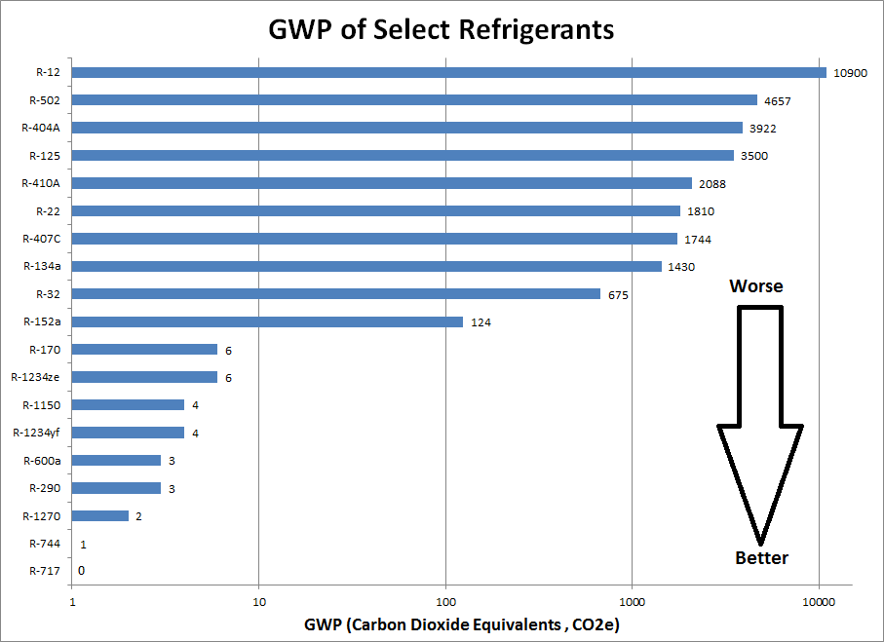
Cold-Climate Design Criteria:
Pick the Right Refrigerant
Source: Images Courtesy of SmithGroup

Slide 44

Cold-Climate Design Criteria:
Pick the Right Refrigerant
  100x 1-Bedroom
  100x 2-Bedroom
  ASPE
    Peak: 1,433 gph for 3 hours
    Off-peak: 158 gph for 8 hours
Source: Images Courtesy of SmithGroup

Slide 45
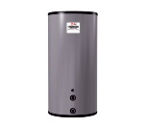
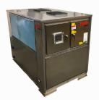

Cold-Climate Design Criteria:
Pick the Right Refrigerant
  100x 1-Bedroom
  100x 2-Bedroom
4 Air-Source R-134a Heat Pumps
4 x 70 A CB @ 480v
176 KVA
COP ~<2 @ 5F OAT
COP: 4.1 @ 40F OAT
Source: Images Courtesy of SmithGroup
2,750 Gallons of Storage
(@ 140F)

Slide 46

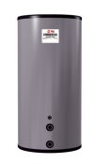
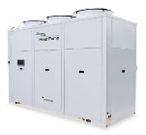
Cold-Climate Design Criteria:
Pick the Right Refrigerant
  100x 1-Bedroom
  100x 2-Bedroom
2 x C02 Heat (R744)
2x 125A CB at 480v
138KVA
COP 2.2 at 5F OAT
COP 3 at 40 F OAT
1,500 Gallons of Storage
(@ 180F)
Source: Images Courtesy of SmithGroup

Slide 47
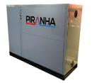
Cold-Climate Design Criteria:
Pick the Right Refrigerant
  100x 1-Bedroom
  100x 2-Bedroom
2 x Waste Heat Recovery Heat Pump (R-513a)
2x 110A CB @ 480v
88 kVA
COP 4.1
2,750 Gallons of Storage
(@ 140F) + ~2,250 Gal Waste Storage Below Grade
Source: Images Courtesy of SmithGroup

Slide 48
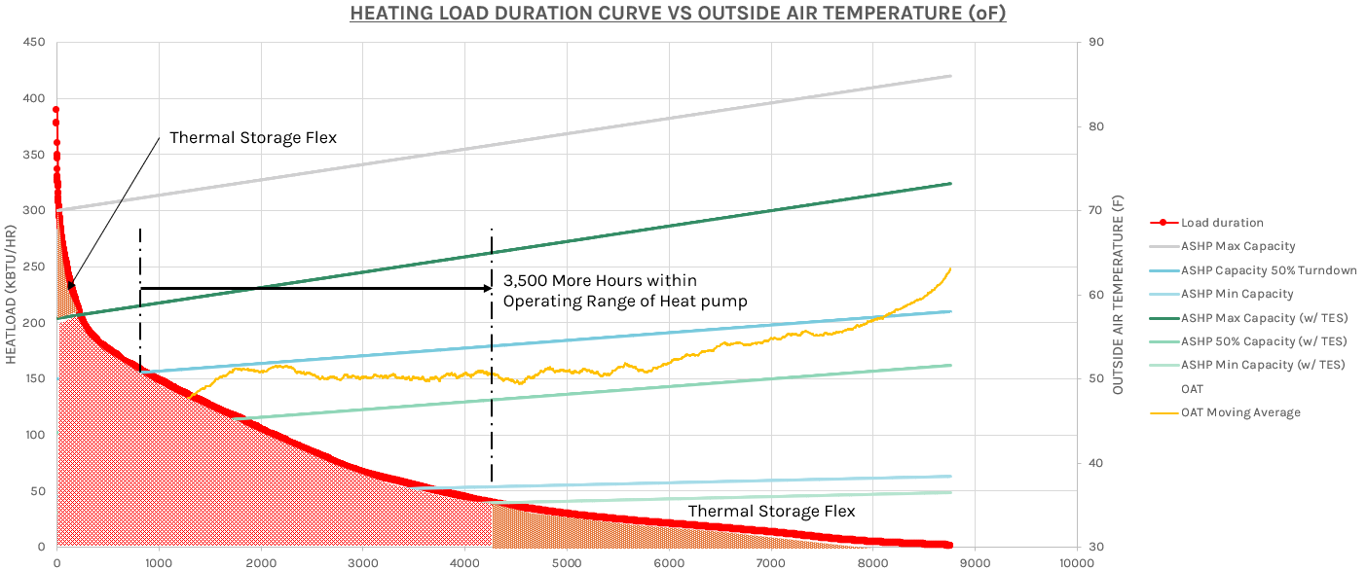
Cold-Climate Design Criteria: Right Size For the Load Profile
Source: Images Courtesy of SmithGroup

Slide 49


Center of Excellence for Building Decarbonization (CEBD)
Four Key Areas
Focused on strategy, thought leadership, industry collaboration, and public advocacy related to building decarbonization
Works with the ASHRAE councils to deliver projects
  Technology
  Education
  Research
  Standards

Slide 50
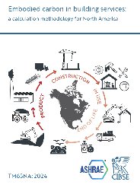





ASHRAE Published Decarbonization Guides

Slide 51



ASHRAE Decarbonization Guides
COMING IN 2025!
Expanded Version 2

Slide 52


Thank You

